Slide 1
Lecture 9
UML Diagrams

Slide 2
UML and System Modeling
Understanding system structure and behavior using standardized diagrams.
Goal: Model, visualize, and communicate system design clearly.

Slide 3
UML Basics
UML (Unified Modeling Language) visualizes object-oriented design.
Standard way to communicate system structure.
Covers both static (class) and dynamic (behavioral) views.

Slide 4
Why UML Matters
Provides a visual language for developers and stakeholders.
Improves clarity, reduces ambiguity in design discussions.
Essential for documentation and maintenance of complex systems.

Slide 5
Categories of UML
Structural:
Class, Object, Component, Deployment
Behavioral:
Use Case, Sequence, Activity, State

Slide 6
Classes and Objects
A class defines attributes (data) and methods (behavior).
An object is a runtime instance of a class.
Example: Class = Student → Objects = Alice, Bob.

Slide 7
Four Core OOP Principles
Encapsulation
keep data safe within classes.
Inheritance
reuse logic across classes.
Polymorphism
same interface, different behaviors.
Abstraction
focus on essentials, hide complexity.

Slide 8
Elements of Class Diagrams
Three compartments: Name | Attributes | Methods.
Visibility symbols: + public, - private, # protected.
Relationships: Association, Aggregation, Composition, Inheritance.

Slide 9
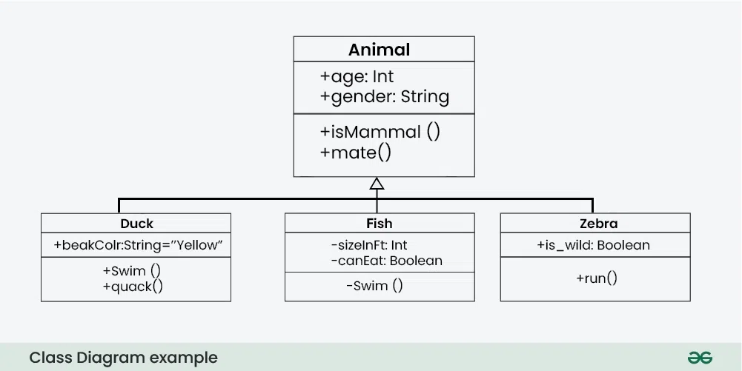
Example of Class Diagrams

Slide 10
Relationships Explained
Association: general link between classes.
Aggregation: whole–part, independent lifetime.
Composition: whole–part, dependent lifetime.
Inheritance: base–derived hierarchy.

Slide 11
Example: Library System Class Diagram
Library, Book, Customer classes.
Member borrows Book → association.
Library contains Books → aggregation.

Slide 12
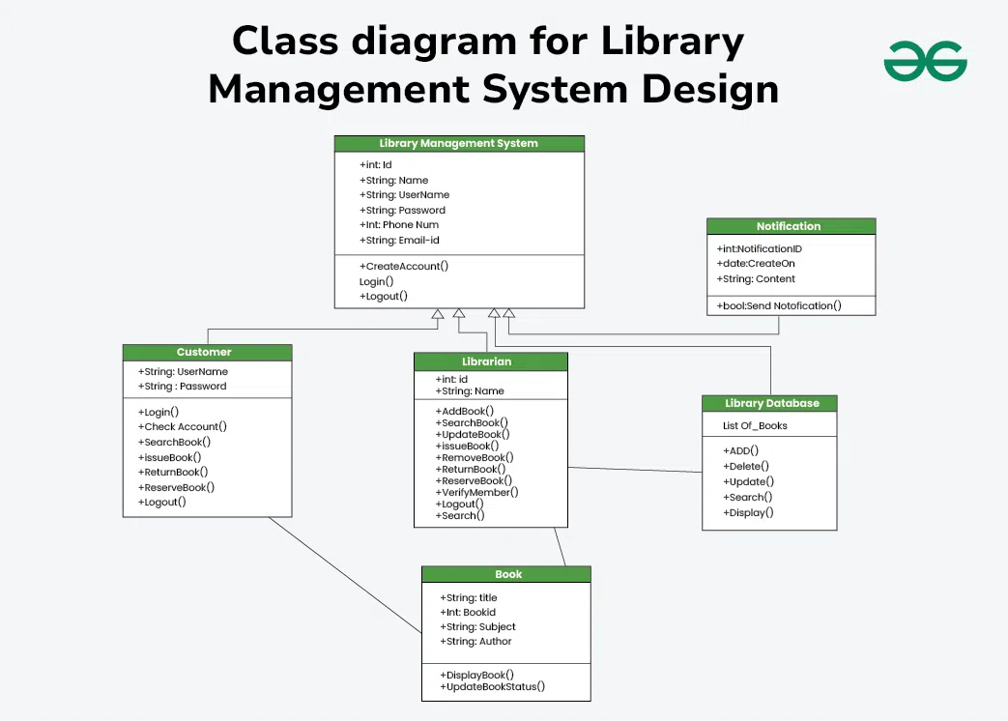

Slide 13
Behavioral Diagrams
Behavioral diagrams show how systems act and react.
Types: Use Case, Activity, Sequence Diagrams.
Capture interactions and workflows effectively.

Slide 14

Use Case Diagrams
Show external actors interacting with the system.
Focus on functional requirements and goals.
Elements: Actors, Use Cases, Relationships.

Slide 15
Example: Library Borrowing Use Case
Actors: Member, Librarian.
Use Cases: Borrow Book, Return Book, Search Catalog.
System boundary encloses all use cases.

Slide 16
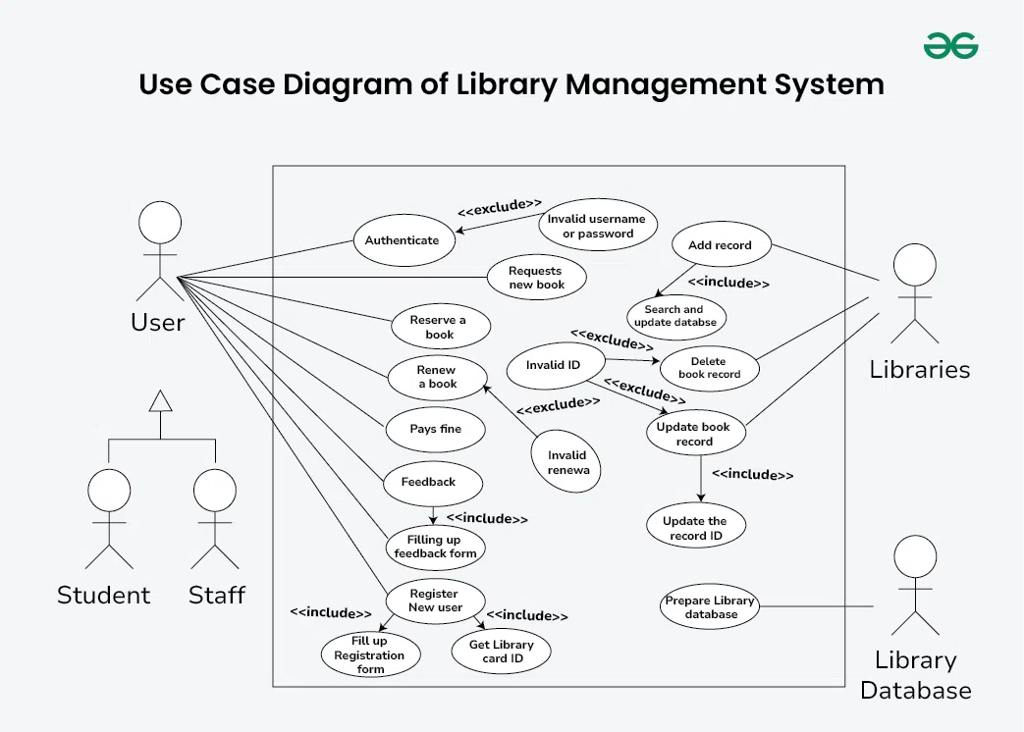
Use Case Diagram Example

Slide 17
Activity Diagrams
Depict
Depict control flow of processes or logic.
Include
Include start/end nodes, activities, decisions.
Show
Show parallel or alternative paths.

Slide 18
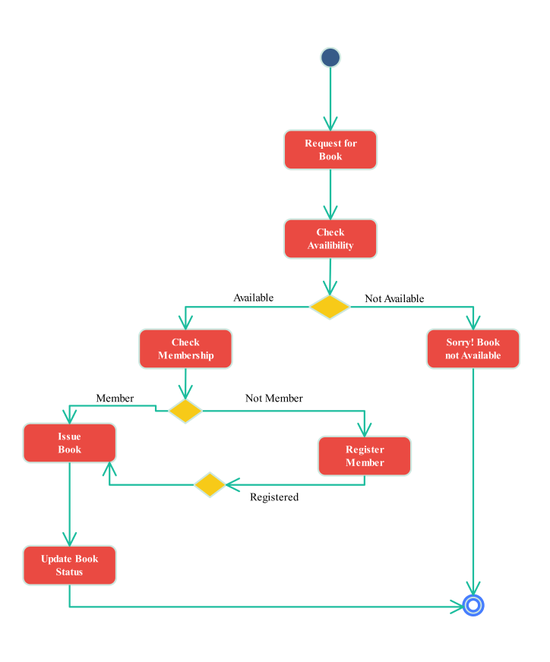
Example: Book Borrowing Workflow

Slide 19
Sequence Diagrams
Show time-ordered message exchanges between objects.
Lifelines represent participants; arrows show messages.
Clarify runtime interactions for specific scenarios.

Slide 20
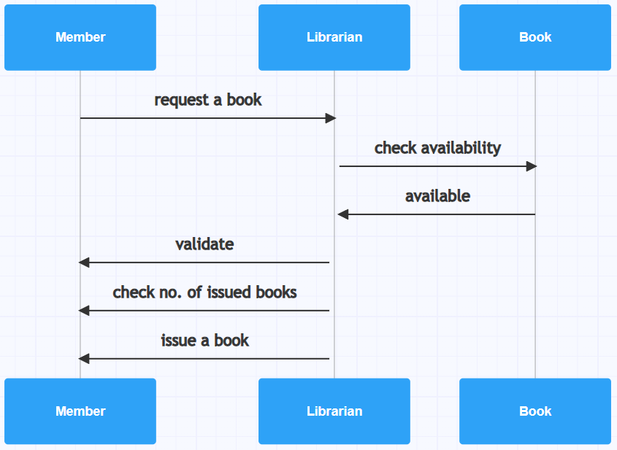
Example: Borrow Book Sequence

Slide 21
UML Diagram Comparison Table
Class Diagram — Structure — Represents object relationships.
Use Case Diagram — Functionality — Captures external interactions.
Activity Diagram — Flow — Models dynamic behavior/workflows.
Sequence Diagram — Interaction — Shows time-ordered messages.

Slide 22
Summary
UML bridges conceptual and implementation design.
Key takeaway: choose diagram type based on the design question.
UML : Foundation for applying Design Patterns.

Slide 23
Exercise
Model a Coffee Ordering App:
1. Identify main actors and use cases.
2. Draw class and sequence diagrams for ordering flow.
3. Explain each diagram’s role in system understanding.

Slide 24
Further Reading & Resources
UML Distilled — Martin Fowler.
Tutorials: GeeksforGeeks UML,
Tools: PlantUML, Draw.io UML Templates, Baeldung Design Patterns.
https://www.lucidchart.com/pages/tutorial/uml
YouTube: UML Diagrams Crash Course (freeCodeCamp).

